Slide 1
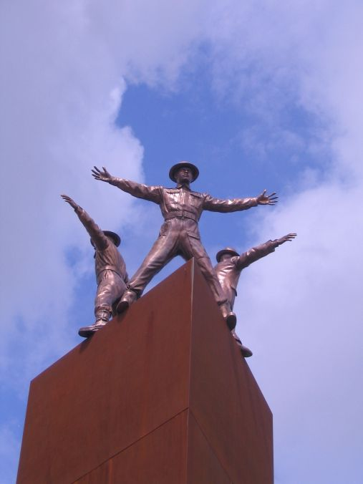
Josefína Sapíková 2.M
Operation
Anthropoid

Slide 2
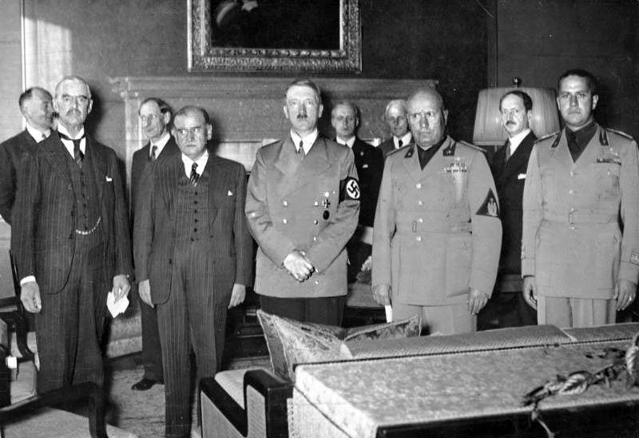
Background
^{29th} - 30th September 1938 – Munich Agreement (also Munich Diktat or Munich Betrayal)
  Czechoslovakia
  had to give up
  Sudetenland
  "About us,
  without us."
President
Eduard
Beneš
resigned
Emil Hácha was elected

Slide 3
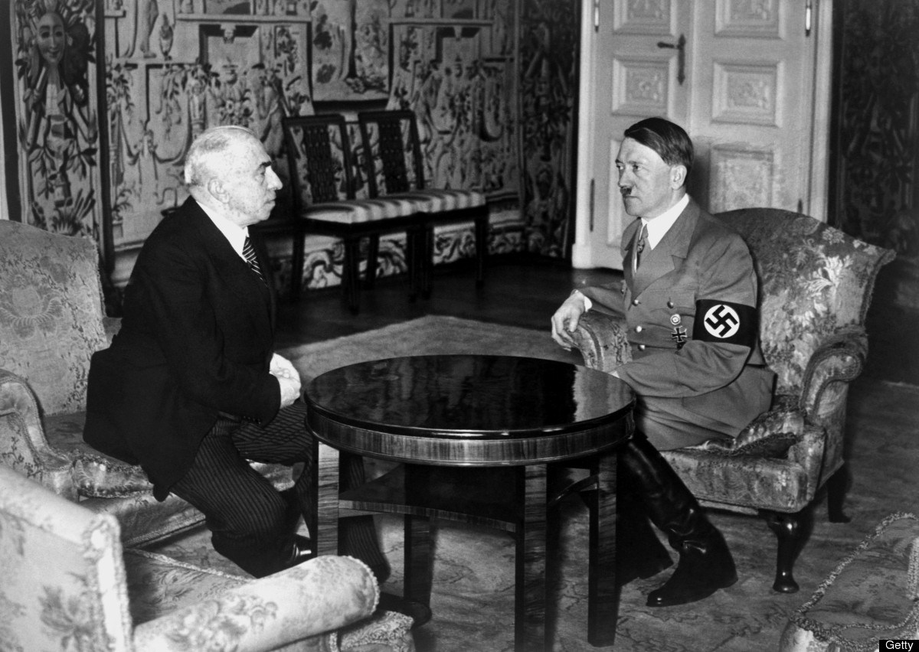
14th March 1939 – Slovakia declared independence
  Hitler intimadated Hácha into accepting the German occupation

Slide 4
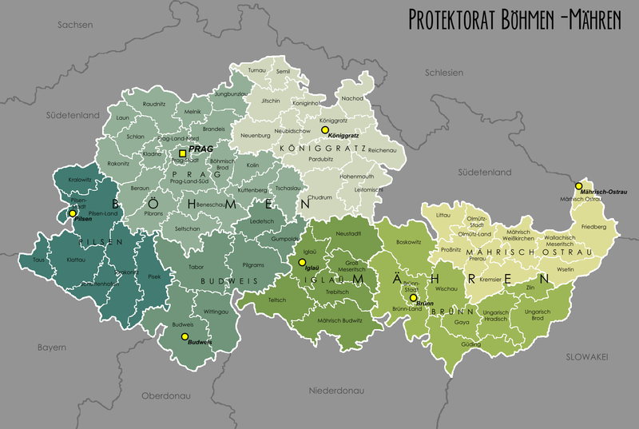
15^{th March 1939}
^{– German invasion}
16th March 1939 – Establishment of the Protectorate of Bohemia and Moravia

Slide 5
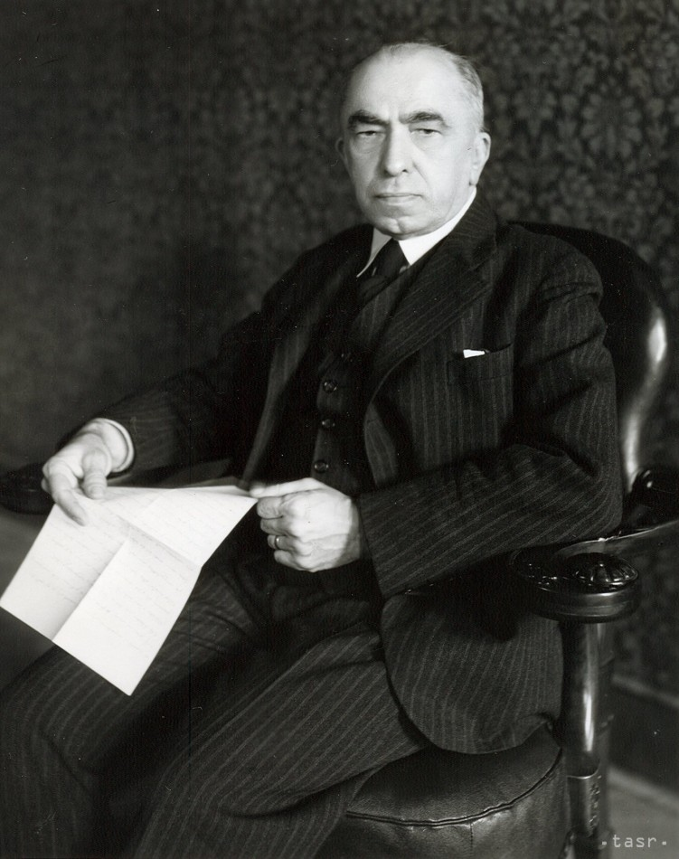
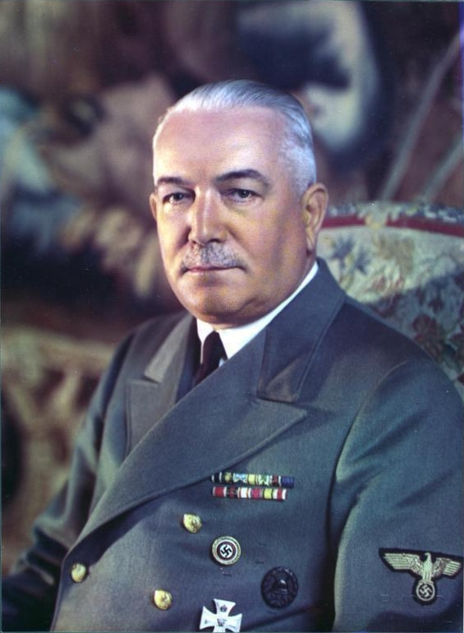
  Emil Hácha remained the head of the state, with no executive power
Real power in the protectorate belonged to the Reichsprotektor
  Konstantin von Neurath (1939 – 1943)
  Officialy until 1943, but he was replaced by Reinhard Heydrich in 1941

Slide 6
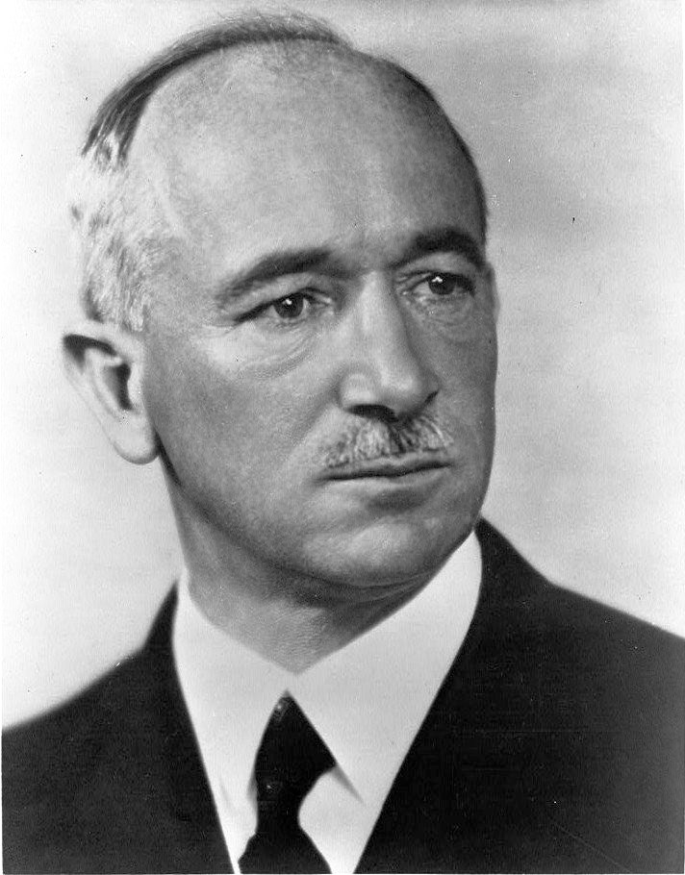
Czechoslovak government in-exile
(9th July 1940)
Also Czechoslovak National Liberation
Committee
Formerly in France, but:
    French government refused to give
    diplomatic status + Nazi occupation
      The Committee had to withdraw to
      London in 1940
  President: Edvard Beneš
Czechoslovak army was recreated
    Soldiers and civilians
        French army
            Great Britain
                1st Czechoslovak
                Independent Brigade
  Many of them volunteered to become paratroopers...

Slide 7
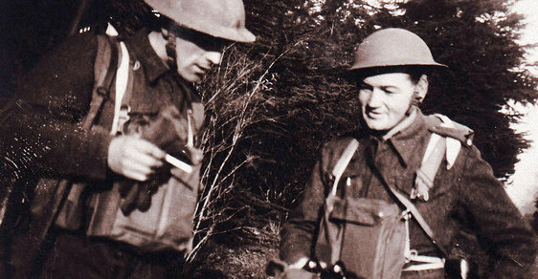
In 1940, a special branch of MI6 was formed
  The Special Operations Executive (SOE)
  recoinnaissance, espionage and irregular warfare in occupied Europe, helping the local resistence
Special Training Schools in Scotland (STS)
  Field craft
  Orienteering
  Topography
  sharp shooting
  close contact
  fighting
  Explosives handling
  Wireless
  operation
  Subversive
  actions
  Physical
  training
  They were divided into
  parachute groups
    The most famous:
                Operation Anthropoid

Slide 8
Since the occupation, there was only a little sign of resistence
  President Beneš was pressured by British intelligence
They needed to raise the spirits of Czechoslovaks as well as show the world they were allies
They decided to assassinate the acting Reichsprotektor, Reinhard Heydrich

Slide 9
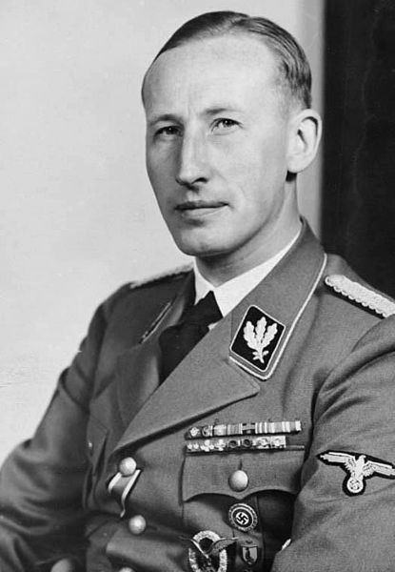
29th September 1941, Reinhard Heydrich became the acting Reichsprotektor
Chief of Reich Main Security Office (RSHA)
SS-Obergruppenführer and General der Polizei
Leader of the Holocaust
He wanted to eliminate any opposition by destroying the resistence

Slide 10
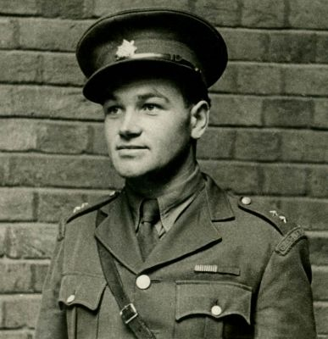
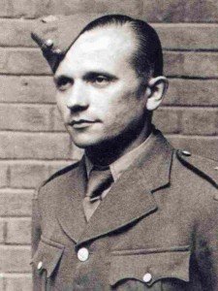
Operation Anthropoid
Anthropoid (greek) -> having the form of human"
  Heydrich's nicknames = "The Butcher of Prague", The Blond Beast"
Preparations since 20th October 1941
SOE chose Jozef Gabčík and Karel Svoboda
  Svoboda had a head injury, later replaced with Jan Kubiš

Slide 11
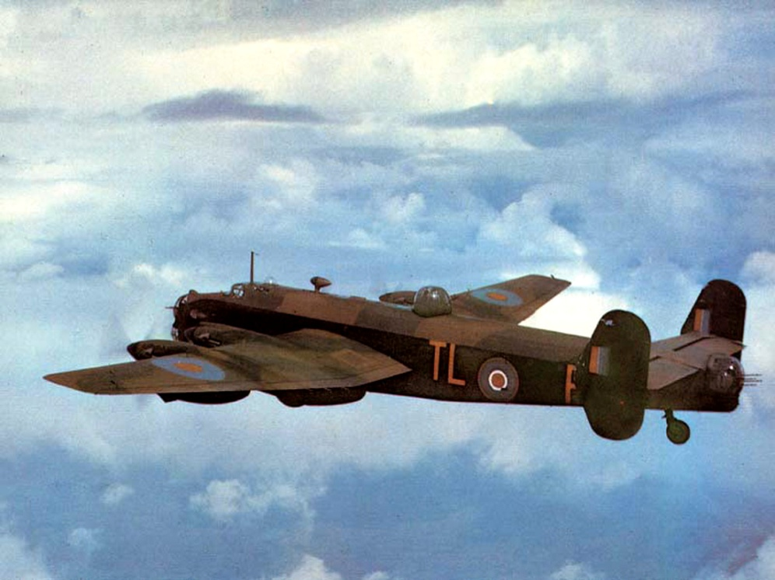
Gabčík, Kubiš, two parachute groups (Silver A, Silver B) and seven Czechoslovak soldiers were airlifted by a Halifax
  22:00, 28th December 1941
They went to Pilsen, where they contacted their allies
  Prague
  Preparations with the help of several families and anti-Nazi organizations
Anthropoid landed near Nehvizdy
  The plan was to land near Pilsen
Gabčík hurt his foot

Slide 12
The Plan
Kill him on a train
  Wasn't possible
Assassinate him on the road in the forest on the way from Heydrich's home to Prague
  They waited several hours. Lt. Adolf Opálka came to bring them back to Prague.
Kill him in Prague

Slide 13
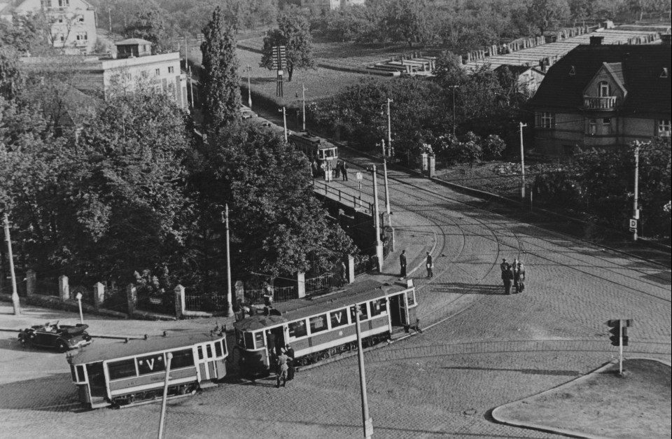
27th May 1942, 10:30 AM
Heydrich drove daily to Prague Castle from Panenské Břežany through Prague 8 – Libeň
    The car was forced to slow down because of a tight curve
      Perfect spot
Gabčík and Kubiš waited at a tram stop
    Josef Valčík (Silver A) was on the lookout

Slide 14
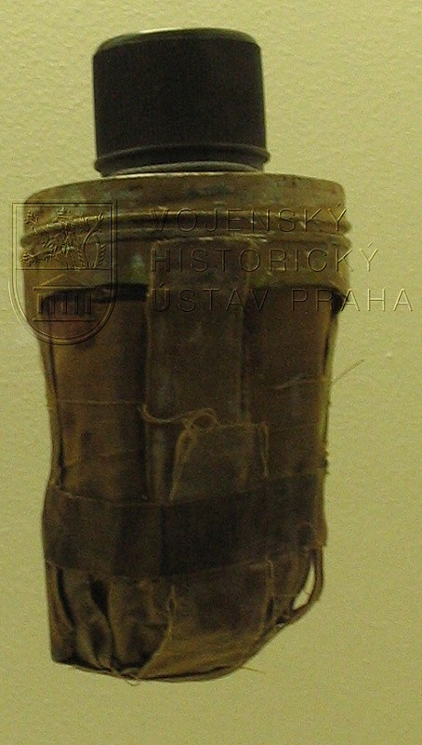
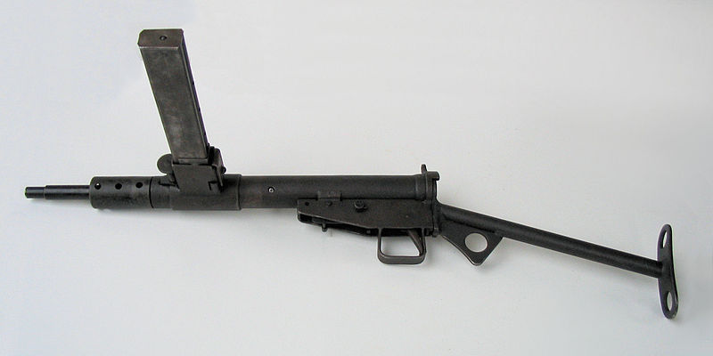
Heydrich's car reached the curve
  Gabčík stepped in front of the car and opened fire – FAILED
  Kubiš threw a modified anti-tank grenade
    It didn't enter the car, but it still HURT Heydrich
    It hurt Kubiš as well
Gabčík and Kubiš the scene
  They were convinced the mission FAILED
Heydrich collapsed and was taken to the hospital

Slide 15
4th June 1942, Reinhard Heydrich died in the hospital
THE MISSION WAS SUCCESSFUL

Slide 16
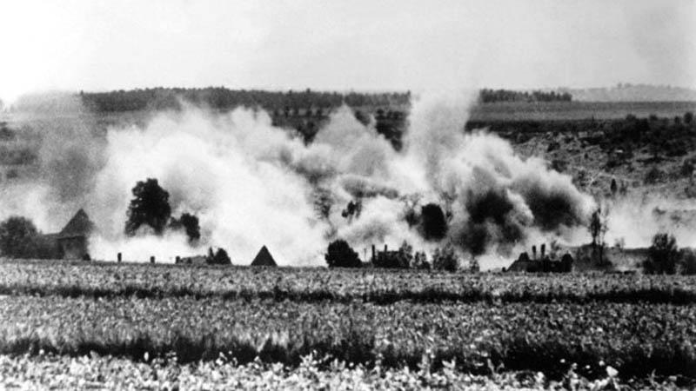
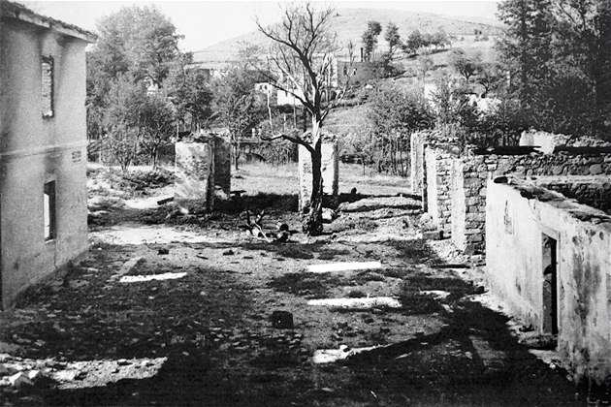
Consenquences
Investigation from the very day of the investigation
Brutal retalitation by Himmler
  13 000 people were arrested
  242 relatives, friends and members of the resistence were executed 24th October 1942 in Mauthausen concentration camp
Villages Lidice and Ležáky were completely destroyed
The only successful government organized assassination of a top-ranking Nazi

Slide 17
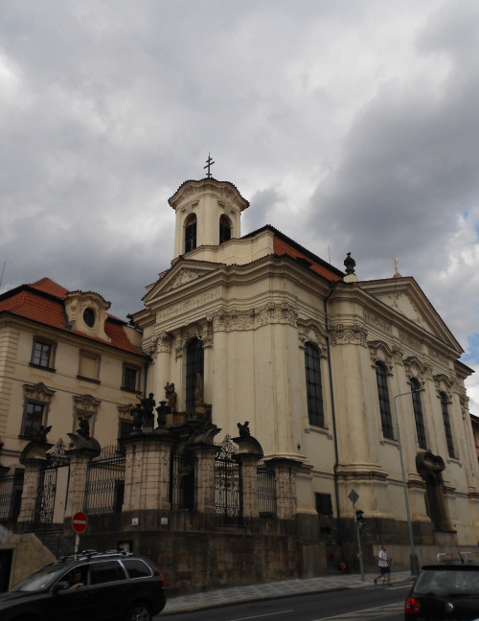
Seven paratroopers, Kubiš, Gabčík, Jan Hrubý, Josef Bublík, Adolf Opálka, Jaroslav Švarc, and Josef Valčík were hidden in the crypt of the Church of Saints Cyril and Methodius
The Germans were unable to locate, until they were betrayed by Karel Čurda for a bounty
  He told the Gestapo names of local contact families
    A young boy was tortured and gave up the name of the church

Slide 18
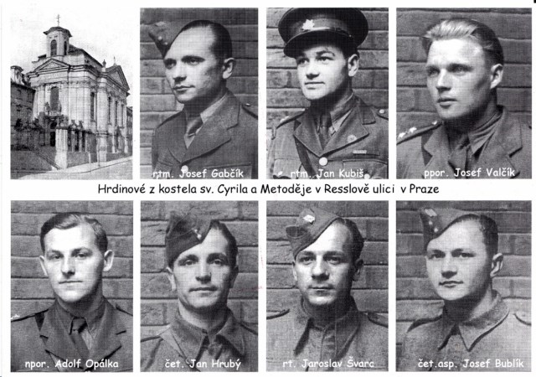

Slide 19
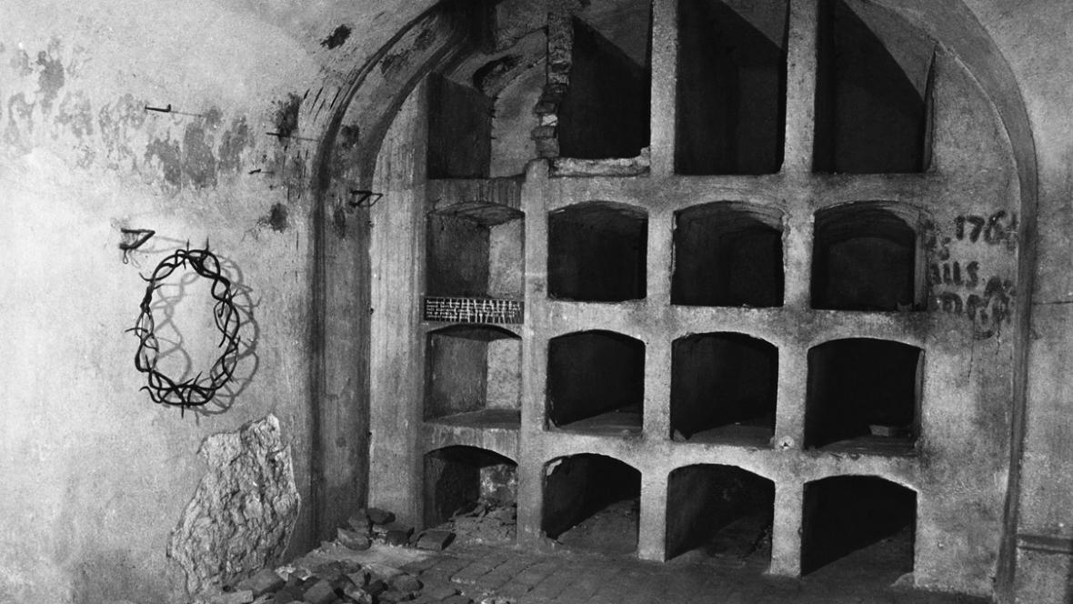
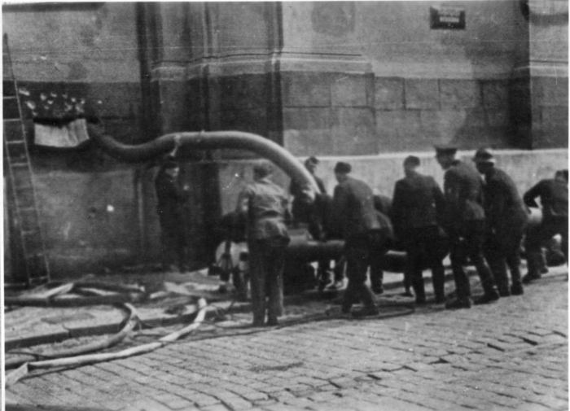
750 German troops armed with hand grenades, submachine guns and machine guns surrounded the church
Kubiš, Opálka and Švarc
were on watch in the
prayer loft
  Killed after two hours
Gabčík, Valčík, Bublík and
Hrubý fought in the crypt
  They tried to dig a tunnel out
  Germans attempted to smoke
  them out and flood the crypt
  Paratroopers commited suicide
All seven dead; 14 Germans killed and 21 wounded

Slide 20
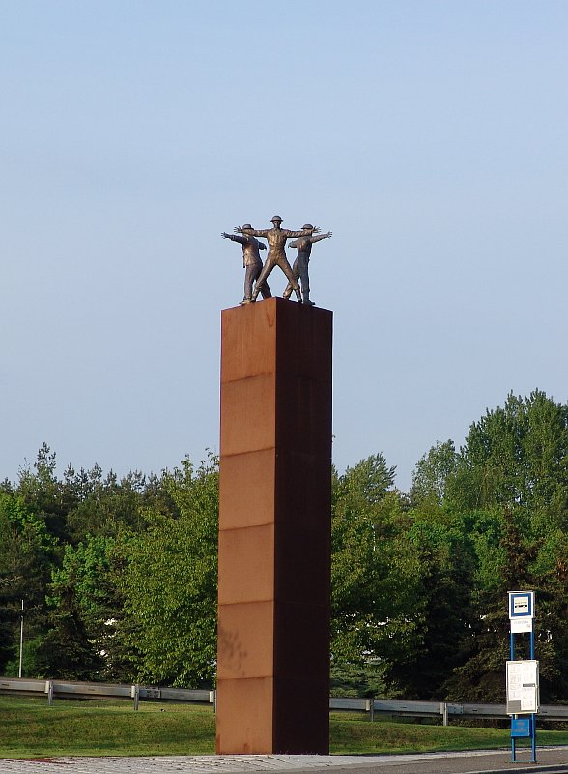
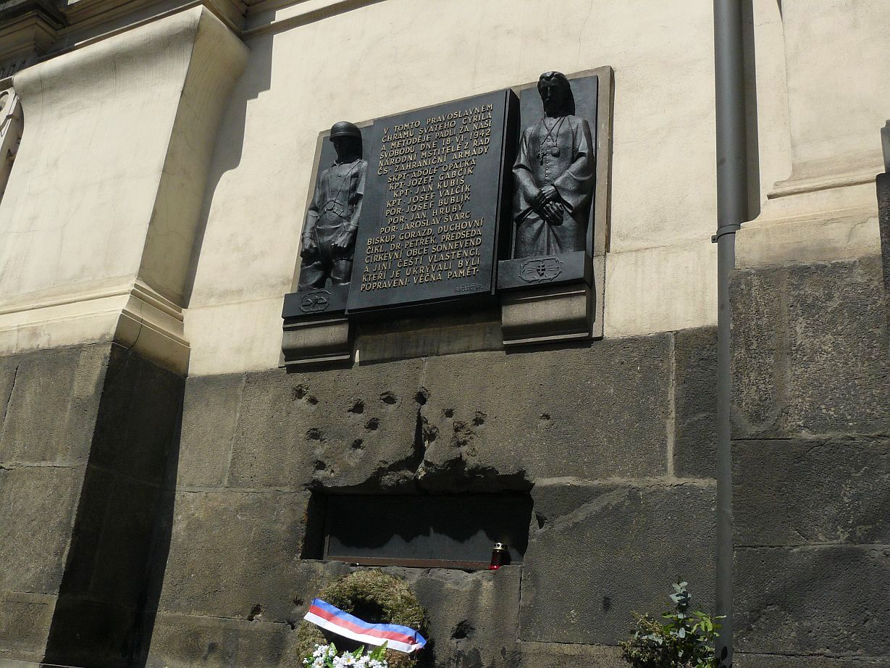

Slide 21
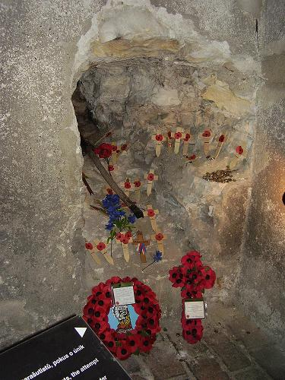
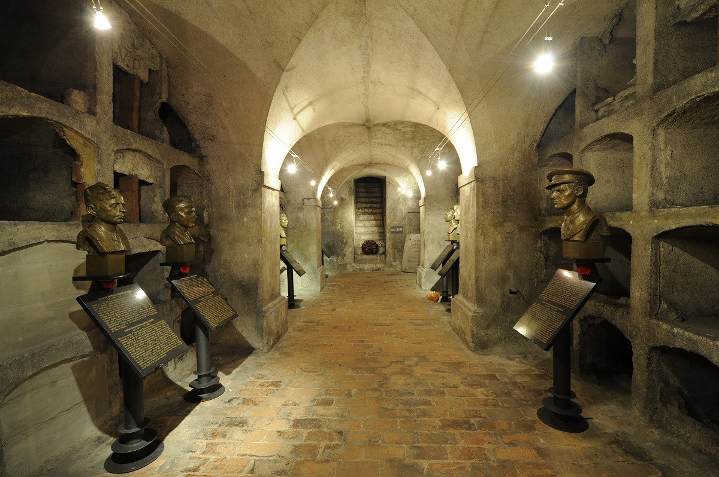

Slide 22
Thank you for attention

